Slide 1


Department of Computer Science and Engineering
Optimizing Railway Station Layout For Enhanced Travel Efficiency
Team Id: B21A2425C20
Dr. Vinodkumar S Professor
Megha Varshinee S J 210701109
Nithisha Paulin S 210701124

Slide 2
Problem Statement and Motivation
Railway stations are complex environments with numerous facilities and locations such as ticket counters, platforms, restrooms, food courts, and waiting areas. The challenges passengers face in navigating large or unfamiliar railway stations, including locating facilities like ticket counters, platforms, restrooms, and food courts. It emphasizes the need for an efficient navigation system to improve the passenger experience, reduce congestion, and facilitate timely travel connections. The proposed solution includes developing intuitive navigation tools with features like detailed maps, real-time directions, accessibility options for individuals with disabilities, and compatibility across platforms such as mobile devices and digital kiosks.

Slide 3
Objectives
Design and develop a fully functional navigation system that computes and displays optimal routes between two points, tailored for indoor environments such as railway stations.
Provides real-time voice-guided navigation with text-to-speech functionality for hands-free assistance, enhancing accessibility and usability.
Does not rely on third-party services like Google Maps API, using custom routing algorithms designed for specific environments.
Prioritizes inclusivity by providing user-friendly navigation solutions, ensuring ease of use for individuals with disabilities or special needs.

Slide 4
Abstract
The navigation system project aims to build an efficient, reliable routing application without utilizing third-party services like Google Maps API. This system will take user input for the start and end locations and generate routes using custom-defined mapping data. It also includes features like text-to-speech instructions for enhanced user interaction. The application is designed for use cases such as indoor navigation or localized outdoor navigation where a custom map can be implemented. Utilizes custom-defined mapping data tailored to specific environments, enabling localized navigation for indoor environment.

Slide 5
System Architecture
The process begins with the user interacts with the system through a web interface (HTML/JavaScript) by inputting a destination query.
The query is received by the backend server, which is likely implemented using the Flask framework.
Then the query is processed using the spaCy natural language processing library to extract relevant information like locations, landmarks, etc.
The processed query extracted the locations are used to query a database (likely containing geographical data) to retrieve their coordinates.

Slide 6
System Architecture
The pathfinding algorithm (implemented using the NetworkX library) is used to calculate the shortest or optimal route between the user's current location and the destination.
Once the path is calculated The route is visualized on a map using the Folium library.
Then the route and directions are converted into spoken instructions using the pyttsx3 library.
Finaly the user receives both visual (map) and auditory (spoken instructions) feedback.

Slide 7
List of Modules
Data Collection and Station Mapping
GPS-Based Positioning
Pathfinding and Route Optimization
NLP and TTS Module
User Interface Module

Slide 8
Data Collection
Data Collection and Station Mapping : The foundation of the navigation system is accurate data collection and mapping of the railway station. This data is critical for setting up an indoor navigation environment, defining Points of Interest (POIs), and creating an accurate graph structure for pathfinding. Data collection might occur through GPS or manual entry of coordinates, and station mapping could be implemented to provide optimized routes between the user's current position and their desired destination
GPS-Based Positioning : The system relies on GPS technology to provide location information. Although GPS accuracy can vary indoors, we optimize its usage within the station for approximate user localization. When the "Get Location" button is clicked, it likely uses the browser's geolocation feature, which communicates with GPS satellites, Wi-Fi, or cellular networks to retrieve the user's coordinates (latitude and longitude).

Slide 9
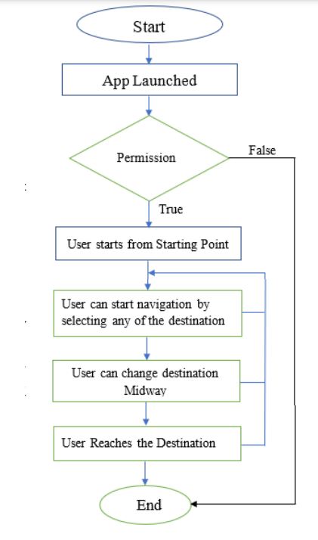
Pathfinding And Route Optimization
Pathfinding and Route Optimization : The system uses NetworkX, a Python library, to create a graph structure that represents the railway station’s layout. This graph-based approach enables efficient route calculations and dynamic pathfinding. The application likely incorporates pathfinding and route optimization to guide users efficiently to their destinations. After obtaining the user's current location through GPS or manual input of coordinates, the system calculates the shortest or most optimal path to the specified destination. Pathfinding algorithms, such as Dijkstra's algorithm, might be used to analyze possible routes and choose the best one based on distance, accessibility, or other factors. This ensures a seamless navigation experience, whether navigating a complex indoor environment or finding points of interest outdoors, optimizing both time and effort for the user.

Slide 10
NLP And TTS Module
NLP for Query Interpretation: Natural Language Processing (NLP) is implemented to allow users to interact with the system using natural language queries, such as asking for directions, searching for locations (e.g., "Where is the nearest restroom?"), or specifying a destination ("Guide me to Platform 5"). NLP helps the system understand and process these textual inputs by recognizing intent, extracting relevant entities (e.g., location names, directions), and converting them into structured data that can be used by the routing and navigation modules.
TTS for Audio Guidance: Text-to-Speech (TTS) technology is integrated to provide real-time, hands-free audio instructions to users. Once the system determines the optimal route, TTS converts the navigation instructions (e.g., "Turn left after 50 meters") into spoken language, guiding users step by step. This is particularly useful for users who need audio assistance while navigating, ensuring a more accessible and user-friendly experience. TTS also allows the system to deliver timely updates, warnings, or changes in the route as users progress through their journey.

Slide 11
User Interface Module
User Interface Design and Interaction Flow: The user interface (UI) is designed to be intuitive and accessible, with a combination of map-based visuals and voice commands for flexible navigation. The Interaction Flow is intuitive the users can manually enter their location and destination. To manually get coordinates for a location, you can use several methods. One common approach is through Google Maps simply open Google Maps, right-click on the location you want, and select "What's here?" The coordinates will appear in a small box at the bottom, which you can then copy. Upon submission, the system processes the inputs and likely displays the optimized route or navigation details. This design balances automation and manual control, ensuring accessibility for a wide range of users and scenarios, including environments where GPS signals may not be available.

Slide 12
Implementation & Results of First Module
Output Screenshot:

Slide 13
Implementation & Results of First Module
Output Screenshot:

Slide 14
Conclusion & Work for Phase II
Conclusion: The Railway Station Indoor Navigation System offers a practical solution for navigating complex railway station environments using GPS technology. This system addresses key user requirements, including accessibility, real-time guidance, and cost-effectiveness, demonstrating the viability of GPS-based navigation within indoor public transportation facilities.
Phase II Objectives:
Backend Development and Pathfinding Engine: Implement the complete backend for Dijkstra’s algorithm to compute real-time shortest paths based on the user’s current position and destination.
Real-Time Location Tracking and Dynamic Environment Management: Integrate location tracking APIs and BLE beacon signals to track the user’s position in real-time.
Text-to-Speech (TTS) Optimization and NLP for Voice Commands: Enhance the TTS functionality for clearer voice guidance, especially in noisy environments, and develop the NLP module to allow users to interact with the system through voice commands for additional navigation support, such as asking for directions or changing their destination.

Slide 15
References
[1] S. Vinodhkumar, P. Kumar, R. Monisha and M. A. Khorakiwala, "Intelligent Agent based Ticket Booking System," 2024 3rd International Conference on Applied Artificial Intelligence and Computing (ICAAIC), Salem, India, 2024, pp. 104-109, doi: 10.1109/ICAAIC60222.2024.10575456
[2] Poornimathi Krishnan., Kumar P (2023), "Enhancing Occlusion Handling in Real-Time Tracking Systems through Geometric Mapping and 3D Reconstruction Validation", International Journal of Engineering and Advanced Technology, Vol. 12,no. 6, pp. 7-13 2024.
[3] Michael Burch, Yves Staudt, Sina Frommer, Janis Uttenweiler, Peter Grupp, Steffen Hähnle, Josia Scheytt, Uwe Kloos, "Public Transport Navigation System," Proceedings of the 2015 IEEE International Conference on Intelligent Transportation Systems (ITSC), pp. 1430-1435,2015.
[4] Rahul Shankar Dhote, Dinesh Vitthalrao Rojatkar, "Real-Time GPS for Railway Automation System " Proceedings of the 2017 International Conference on Intelligent Transportation Systems and Smart Cities (ICITSSC), pp. 49-53, 2017.

Slide 16
Thank You

